Slide 1
SDLC and Agile Development
Rr Octanty Mulianingtyas, S.Kom, M.Sc

Slide 2
TABLE OF CONTENTS
01.
02.
03.
SDLC Method
Agile
Definisi Software Engineering Process

Slide 3
01.
Definisi Software Engineering Process

Slide 4
Definisi Software Engineering Process
A process is a collection of activities, actions, and tasks that are performed when some work product is to be created.
-An activity strives to achieve a broad objective (e.g., communication with stakeholders)
-An action (e.g., architectural design) encompasses
a set of tasks that produce a major work product (e.g., an architectural design model).
-A task focuses on a small, but well-defined objective (e.g., conducting a unit test) that produces a tangible outcome.

Slide 5
Definisi Software Engineering Process
An adaptable approach that enables the people doing the work (the software team) to pick and choose the appropriate set of work actions and tasks

Slide 6

Software Engineering Process
Communication.
communicate and collaborate with the customer (and other
Stakeholders. The intent is to understand stakeholders’ objectives for the
project and to gather requirements that help define software features and
Functions.
Planning.
creates a “map” that helps guide the team as it makes the journey. The map—called a
software project plan—defines the software engineering work by describing
the technical tasks to be conducted, the risks that are likely, the resources
that will be required, the work products to be produced, and a work
schedule.
Notes:
Firstly, repeated, immediate applicability in a certain class of working conditions;
Secondly, reliable enough reproducibility, when applied properly, of certain practical effect (actually or presumably useful); Thirdly, identifiability - possibility to distinguish objectively enough and accurately this concrete resource from any other while the resource is considered as an object of application, adoption, transfer, etc.

Slide 7
Software Engineering Process
Modelling.
A software engineer creates models to better understand software requirements and the design that will achieve those requirements.
Construction. This activity combines code generation (either manual or
automated) and the testing that is required to uncover errors in the code.
Deployment. The software (as a complete entity or as a partially completed
increment) is delivered to the customer who evaluates the delivered
product and provides feedback based on the evaluation.

Slide 8
02.
SDLC Method

Slide 9
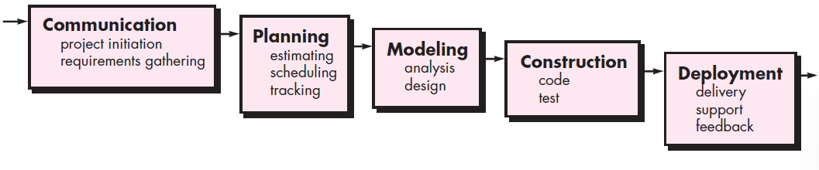
Waterfall Model
The waterfall model, sometimes called the classic life cycle, suggests a systematic,
sequential approach to software development

Slide 10
Problems of Waterfall Model
1. Real projects rarely follow the sequential flow that the model proposes.
Although the linear model can accommodate iteration, it does so indirectly.
As a result, changes can cause confusion as the project team proceeds.
2. It is often difficult for the customer to state all requirements explicitly. The
waterfall model requires this and has difficulty accommodating the natural
uncertainty that exists at the beginning of many projects.
3. The customer must have patience. A working version of the program(s) will
not be available until late in the project time span. A major blunder, if undetected until the working program is reviewed, can be disastrous.
However, it can serve as a useful process model
in situations where requirements are fixed and work is to proceed to completion in a linear manner.
Notes:
Secondly, reliable enough reproducibility, when applied properly, of certain practical effect (actually or presumably useful); Thirdly, identifiability - possibility to distinguish objectively enough and accurately this concrete resource from any other while the resource is considered as an object of application, adoption, transfer, etc.

Slide 11
Incremental Model
The incremental model combines elements of linear and parallel process flows
The incremental model applies linear sequences in a staggered fashion as calendar time progresses.
When an incremental model is used, the first increment is often a core product.
That is, basic requirements are addressed but many supplementary features (some
known, others unknown) remain undelivered. The core product is used by the customer
(or undergoes detailed evaluation).
As a result of use and/or evaluation, a plan is developed for the next increment. The plan addresses the modification of the core product to better meet the needs of the customer and the delivery of additional features and functionality. This process is repeated following the delivery of each increment, until the complete product is produced.

Slide 12
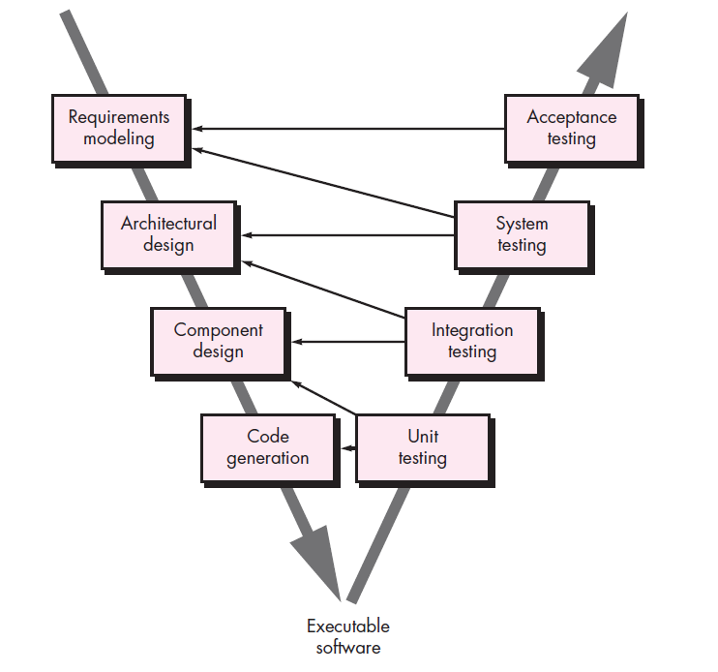
V-Model
The V-model depicts the relationship of quality assurance actions to the actions associated with communication, modeling, and early construction activities.
A. Requirements analysis (SRS)
In the Requirements analysis phase, the requirements of the proposed system are collected by analyzing the needs of the user(s).
B. System Design/ Functional Specifications
Systems design is the phase where system engineers analyze and understand the business of the proposed system by studying the user requirements document. They figure out possibilities and techniques by which the user requirements can be implemented.
C. Architecture Design/ Physical Design
The software specification document which serves as a blueprint for the development phase is generated. This document contains the general system organization, menu structures, data structures etc
Notes:
A variation in the representation of the waterfall model is called the V-model
Secondly, reliable enough reproducibility, when applied properly, of certain practical effect (actually or presumably useful); Thirdly, identifiability - possibility to distinguish objectively enough and accurately this concrete resource from any other while the resource is considered as an object of application, adoption, transfer, etc.

Slide 13
V-Model
D. Module Design (Coding)/ Low Level Design
The low level design document or program specifications will contain a detailed functional logic of the module, in pseudo code:
- database tables, with all elements, including their type and size
- all interface details with complete API references
- error message listings
- Complete input and outputs for a module.
E. Unit Testing
The module design phase can also be referred to as low-level design. The low level design document or program specifications will contain a detailed functional logic of the module, in pseudo code:
- database tables, with all elements, including their type and size
- all interface details with complete API references
- error message listings
F. Integration Testing
In integration testing the separate modules will be tested together to expose faults in the interfaces and in the interaction between integrated components. Testing is usually black box as the code is not directly checked for errors.
G. System Testing
System testing will compare the system specifications against the actual system. After the integration test is com-pleted, the next test level is the system test. System testing checks if the integrated product meets the specified re-quirements.
H. User Acceptance Testing
Acceptance testing is the phase of testing used to determine whether a system satisfies the requirements specified in the requirements analysis phase.
Notes:
A variation in the representation of the waterfall model is called the V-model
Secondly, reliable enough reproducibility, when applied properly, of certain practical effect (actually or presumably useful); Thirdly, identifiability - possibility to distinguish objectively enough and accurately this concrete resource from any other while the resource is considered as an object of application, adoption, transfer, etc.

Slide 14
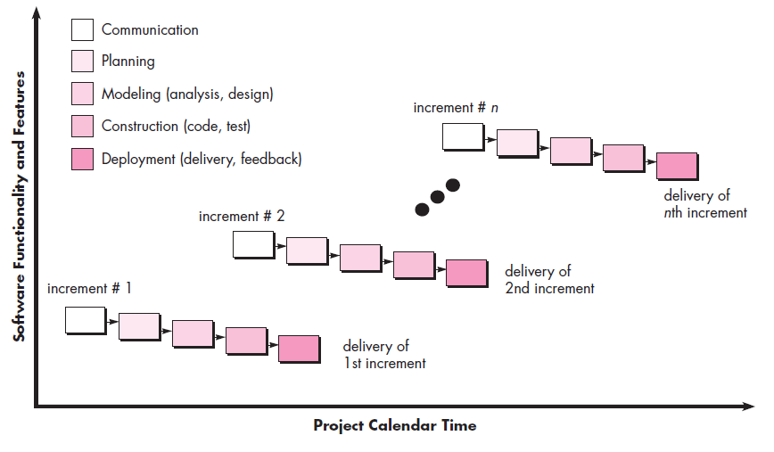
Incremental Model
The incremental process model focuses on the delivery of an operational product
with each increment. Early increments are stripped-down versions of the final product,
but they do provide capability that serves the user and also provide a platform
for evaluation by the user.
Notes:
Incremental development is particularly useful when staffing is unavailable for a
complete implementation by the business deadline that has been established for the
project. Early increments can be implemented with fewer people. If the core product
is well received, then additional staff (if required) can be added to implement the next
increment. In addition, increments can be planned to manage technical risks

Slide 15
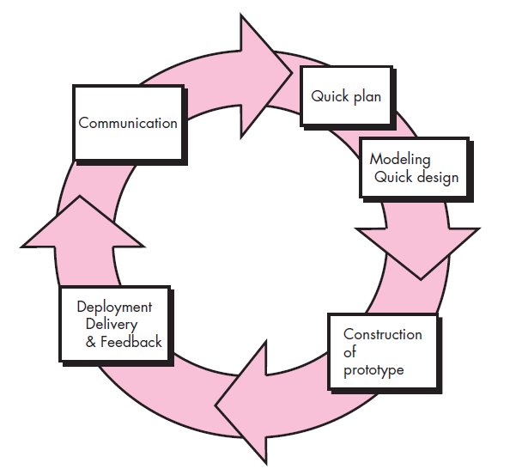
Evolutionary Process Models
The prototyping paradigm begins with communication then the quick design leads to the construction of a prototype. The prototype is
deployed and evaluated by stakeholders, who provide feedback that is used to further
refine requirements. Iteration occurs as the prototype is turned to satisfy the
needs of various stakeholders, while at the same time enabling you to better understand
what needs to be done.
Notes:
You meet with
other stakeholders to define the overall objectives for the software, identify whatever
requirements are known, and outline areas where further definition is mandatory. A
prototyping iteration is planned quickly, and modeling (in the form of a “quick design”)
occurs. A quick design focuses on a representation of those aspects of the software
that will be visible to end users (e.g., human interface layout or output display

Slide 16
03.
Agile

Slide 17
Agile Process
Any agile software process is characterized in a manner that addresses a number of key assumptions about the majority of software projects:
1. It is difficult to predict in advance which software requirements will persist
and which will change. It is equally difficult to predict how customer
priorities will change as the project proceeds.
2. For many types of software, design and construction are interleaved. That is,
both activities should be performed in tandem so that design models are
proven as they are created. It is difficult to predict how much design is
necessary before construction is used to prove the design.
3. Analysis, design, construction, and testing are not as predictable (from a
planning point of view) as we might like.

Slide 18
Agile Principle
1. Our highest priority is to satisfy the customer through early and continuous
delivery of valuable software.
2. Welcome changing requirements, even late in development. Agile processes
harness change for the customer’s competitive advantage.
3. Deliver working software frequently, from a couple of weeks to a couple of
months, with a preference to the shorter timescale.
4. Business people and developers must work together daily throughout the
Project.
5. Build projects around motivated individuals. Give them the environment and
support they need, and trust them to get the job done.

Slide 19
Agile Principle
8. Agile processes promote sustainable development. The sponsors, developers,
and users should be able to maintain a constant pace indefinitely.
9. Continuous attention to technical excellence and good design enhances
agility.
10. Simplicity—the art of maximizing the amount of work not done—is
essential.
11. The best architectures, requirements, and designs emerge from self–
organizing teams.
12. At regular intervals, the team reflects on how to become more effective, then
tunes and adjusts its behavior accordingly.

Slide 20
Human Factors of Agile
Competence.
Innate talent, specific software-related skills, and overall knowledge of the process that the team has chosen to apply. Skill and knowledge of process can and should be taught to all people who serve as agile team members.
2. Common focus.
Although members of the agile team may perform different tasks and bring different skills to the project, all should be focused on one
Goal (time promised)
3. Collaboration.
Software engineering (regardless of process) is about assessing, analyzing, and using information that is communicated to the software team;

Slide 21
Human Factors of Agile
Decision-making ability. Any good software team (including agile teams)
must be allowed the freedom to control its own destiny. This implies that the
team is given autonomy—decision-making authority for both technical and
project issues.
Fuzzy problem-solving ability. Software managers must recognize that
the agile team will continually have to deal with ambiguity and will continually
be buffeted by change. In
Mutual trust and respect.
Self-organization. In the context of agile development, self-organization
implies three things:
(1) the agile team organizes itself for the work to be
done,
(2) the team organizes the process to best accommodate its local environment,
(3) the team organizes the work schedule to best achieve delivery of the software increment

Slide 22
Human Factors of Agile
Competence.
Innate talent, specific software-related
skills, and overall knowledge of the process that the team has chosen to
apply. Skill and knowledge of process can and should be taught to all people
who serve as agile team members.
Common focus.
Although members of the agile team may perform different
tasks and bring different skills to the project, all should be focused on one
Goal (time promised)
Collaboration.
Software engineering (regardless of process) is about assessing,
analyzing, and using information that is communicated to the software
team;

Slide 23
Extreme Programming
Communication: between software engineers and
other stakeholders
Simplicity: XP restricts developers to design only for immediate needs,
rather than consider future needs.
Feedback : derived from three sources: the implemented software itself, the customer, and other software team members. By designing and implementing an effective testing strategy
Courage: A better word might be discipline. For example, there is often significant pressure to design for future requirements.
By following each of these values, the agile team inculcates Respect among it members, between other stakeholders and team members, and indirectly, for the software itself

Slide 24
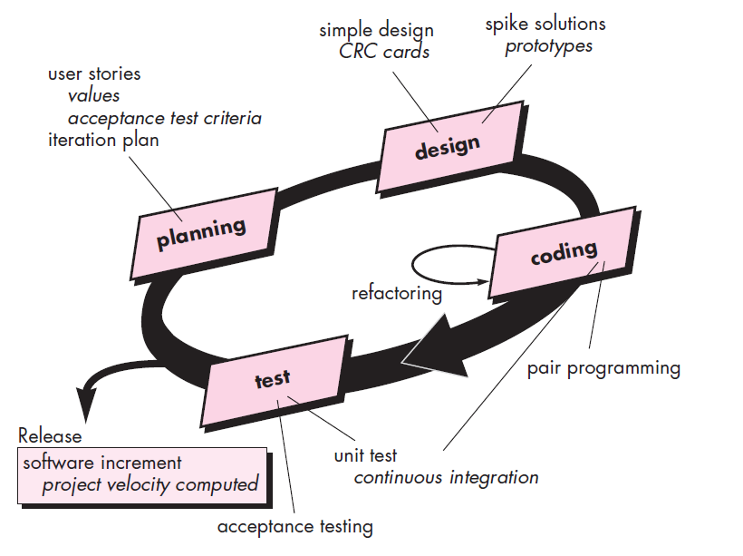
Extreme Programming Process
Extreme Programming uses an object-oriented approach

Slide 25
Industrial XP
Industrial Extreme Programming (IXP) in the following
manner: “IXP is an organic evolution of XP.
Readiness assessment.
(1) an appropriate development environment exists to support IXP,
(2) the team will be populated by the proper set of stakeholders,
(3) the organization has a distinct quality program and supports continuous improvement,
(4) the organizational culture will support the new values of an agile
team, and
(5) the broader project community will be populated appropriately.

Slide 26
Industrial XP
Project Community
The community members and their roles should be explicitly defined and mechanisms for communication and coordination between community members should be
Established.
Project chartering.
The IXP team assesses the project itself to determine whether an appropriate business justification for the project exists and whether the project will further the overall goals and objectives of the organization
Test-driven management.
An IXP project requires measurable criteria for
assessing the state of the project and the progress that has been made to
date.

Slide 27
Industrial XP
Retrospectives. An IXP team conducts a specialized technical review
after a software increment is delivered.
Continuous learning. Because learning is a vital part of continuous
process improvement, members of the XP team are encouraged (and possibly,
incented) to learn new methods and techniques that can lead to a higher quality product.

Slide 28
Scrum
Scrum principles are consistent with the agile manifesto and are used to guide development activities within a process that incorporates the following framework activities: requirements, analysis, design, evolution, and delivery

Slide 29
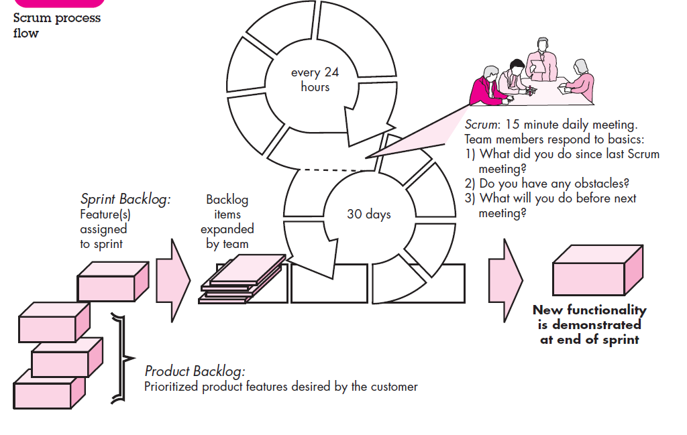
Scrum

